Slide 1
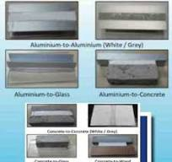
TESON TMS-600 HYBRID SEALANT APPLICATION REFERENCE
Remove old sealant , Apply TMS-600
No Odor , Low modulus ,Bubble free
Applicable for Damp surface
50 % Total Joint Movement . Paintable
Potable water compliance , SIRIM compliance
Multiple substrate compliance ( Per insert )

